Slide 1
convolutional neural network (CNN),
https://medium.com/@draj0718/convolutional-neural-networks-cnn-architectures-explained-716fb197b243

Slide 2
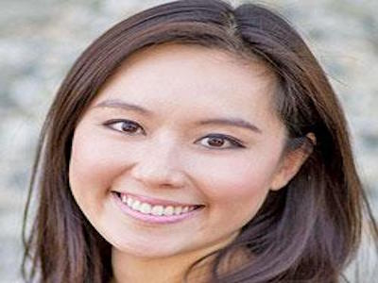
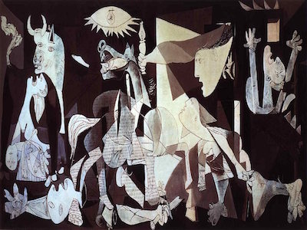
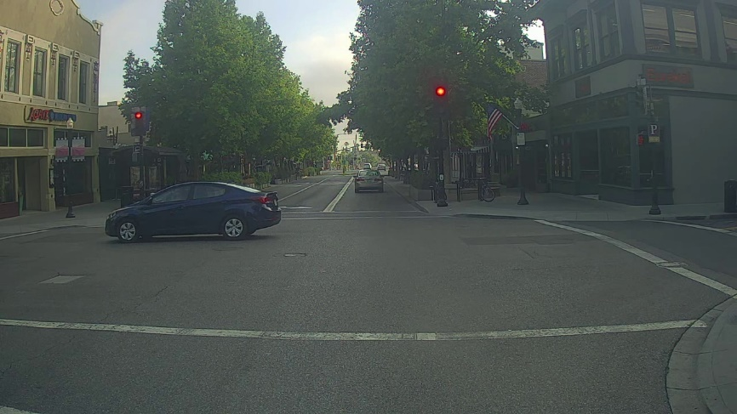
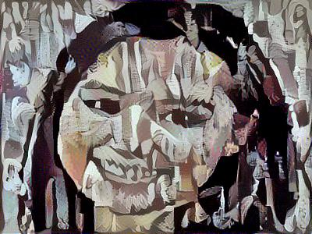
Computer Vision Problems
Image Classification
Neural Style Transfer
Cat? (0/1)
64x64
Object detection

Slide 3
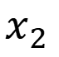
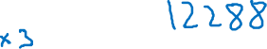
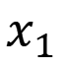
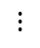
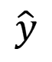
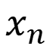

Deep Learning on large images
Cat? (0/1)
64*64*3=12288
64x64
$$x_{1}$$
$$x_{2}$$
$$⋮$$
$$⋮$$
$$⋮$$
$$\hat{y}$$
1000*1000*3=3 million
$$x_{n}$$

Slide 4
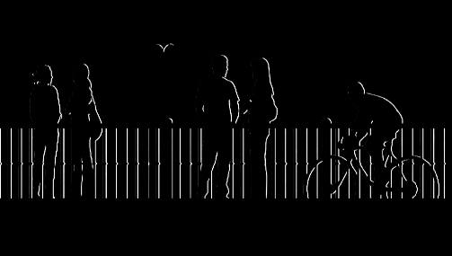
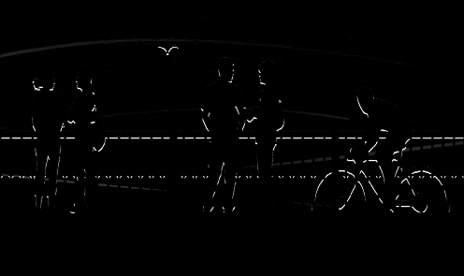
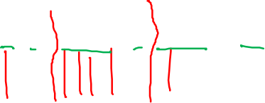
Computer Vision Problem
vertical edges
horizontal edges

Slide 5
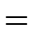
Vertical edge detection examples
10 | 10 | 10 | 0 | 0 | 0
10 | 10 | 10 | 0 | 0 | 0
10 | 10 | 10 | 0 | 0 | 0
10 | 10 | 10 | 0 | 0 | 0
10 | 10 | 10 | 0 | 0 | 0
10 | 10 | 10 | 0 | 0 | 0
0 | 30 | 30 | 0
0 | 30 | 30 | 0
0 | 30 | 30 | 0
0 | 30 | 30 | 0
1 | 0 | -1
1 | 0 | -1
1 | 0 | -1
$$∗$$
$$=$$
0 | 0 | 0 | 10 | 10 | 10
0 | 0 | 0 | 10 | 10 | 10
0 | 0 | 0 | 10 | 10 | 10
0 | 0 | 0 | 10 | 10 | 10
0 | 0 | 0 | 10 | 10 | 10
0 | 0 | 0 | 10 | 10 | 10
0 | -30 | -30 | 0
0 | -30 | -30 | 0
0 | -30 | -30 | 0
0 | -30 | -30 | 0
1 | 0 | -1
1 | 0 | -1
1 | 0 | -1
$$∗$$
$$=$$
Notes:
Dark lo light transition

Slide 6
Vertical and Horizontal Edge Detection
1 | 0 | -1
1 | 0 | -1
1 | 0 | -1
1 | 1 | 1
0 | 0 | 0
-1 | -1 | -1
Vertical
Horizontal
10 | 10 | 10 | 0 | 0 | 0
10 | 10 | 10 | 0 | 0 | 0
10 | 10 | 10 | 0 | 0 | 0
0 | 0 | 0 | 10 | 10 | 10
0 | 0 | 0 | 10 | 10 | 10
0 | 0 | 0 | 10 | 10 | 10
0 | 0 | 0 | 0
30 | 10 | -10 | -30
30 | 10 | -10 | -30
0 | 0 | 0 | 0
1 | 1 | 1
0 | 0 | 0
-1 | -1 | -1
$$∗$$
$$=$$

Slide 7
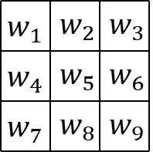
Learning to detect edges
1 | 0 | -1
1 | 0 | -1
1 | 0 | -1
1 | 0 | -1
2 | 0 | -2
1 | 0 | -1
3 | 0 | -3
10 | 0 | -10
3 | 0 | -3
3 | 0 | 1 | 2 | 7 | 4
1 | 5 | 8 | 9 | 3 | 1
2 | 7 | 2 | 5 | 1 | 3
0 | 1 | 3 | 1 | 7 | 8
4 | 2 | 1 | 6 | 2 | 8
2 | 4 | 5 | 2 | 3 | 9
$w_{1}$ | $$w_{2}$$ | $$w_{3}$$
$w_{4}$ | $$w_{5}$$ | $$w_{6}$$
$w_{7}$ | $$w_{8}$$ | $$w_{9}$$
Notes:
eged at different orientation
45 degree
75 degree

Slide 8
Convolutional neural network (CNN),
A convolutional neural network (CNN), is a network architecture for deep learning which learns directly from data.
CNNs are particularly useful for finding patterns in images to recognize objects.
They can also be quite effective for classifying non-image data such as audio, time series, and signal data.

Slide 9
CNN Architecture

Slide 10
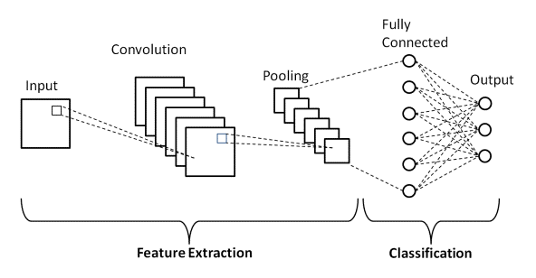
CNN Architecture

Slide 11
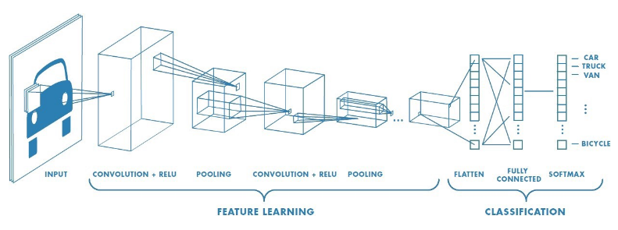
CNN Architecture

Slide 12
CNN Architecture
1. Input Layer
2. Convolutional layer
3. Pooling layer
4. Fully-connected (FC) layer
5. Output Layer

Slide 13
Layers used to build CNN
Convolutional neural networks are distinguished from other neural networks by their superior performance with image, speech, or audio signal inputs.
They have three main types of layers, which are:
Convolutional layer
Pooling layer
Fully-connected (FC) layer

Slide 14
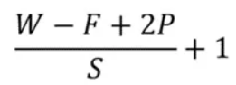
Convolutional layer
This layer is the first layer that is used to extract the various features from the input images.
In this layer, We use a filter or Kernel method to extract features from the input image.

Slide 15
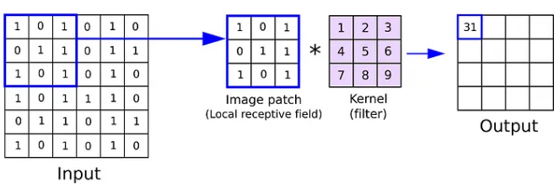
Kernel or Filter or Feature Detectors
The kernel is nothing but a filter that is used to extract the features from the images.
Output/Feature Map

Slide 16
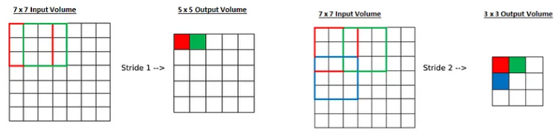
Stride
Stride is a parameter of the neural network’s filter that modifies the amount of movement over the image or video.
we had stride 1 so it will take one by one.
If we give stride 2 then it will take value by skipping the next 2 pixels.

Slide 17
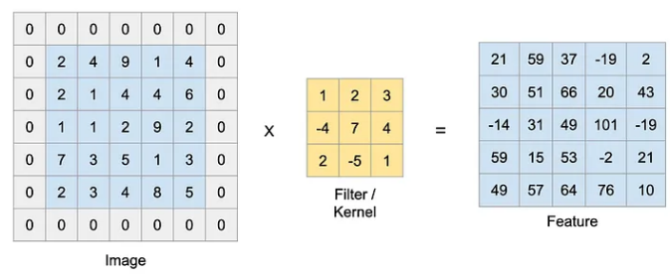
Padding
Padding is a term relevant to convolutional neural networks as it refers to the number of pixels added to an image when it is being processed by the kernel of a CNN.
For example, if the padding in a CNN is set to zero, the size of the image will go smaller.
We have to avoid that because we want to preserve the original size of the image to extract some low-level features.
Therefore, we will add some extra pixels outside the image.

Slide 18
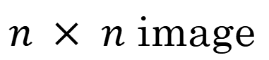
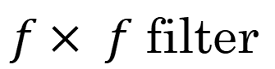

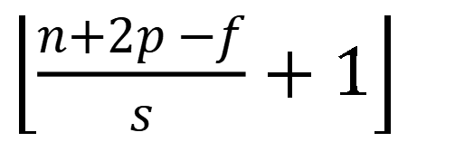
Summary of convolutions
$n × n$ image
$f× f$ filter
padding p
stride s
$\left\lfloor \frac{n+2p −f}{s}+1\right\rfloor$
$\left\lfloor \frac{n+2p −f}{s}+1\right\rfloor$
$$×$$

Slide 19
Example
Padding=0, Stride 2, n=7x7, filter=3x3
2 | 3 | 7 | 4 | 6 | 2 | 9
6 | 6 | 9 | 8 | 7 | 4 | 3
3 | 4 | 8 | 3 | 8 | 9 | 7
7 | 8 | 3 | 6 | 6 | 3 | 4
4 | 2 | 1 | 8 | 3 | 4 | 6
3 | 2 | 4 | 1 | 9 | 8 | 3
0 | 1 | 3 | 9 | 2 | 1 | 4
3
4
4
3
4
3
4
4
4
1
0
2
1
0
1
2
0
2
-1
0
3
4
4
-1
3
0
-1
3
4
4
3
0
3
3 | 4 | 4
1 | 0 | 2
-1 | 0 | 3
3
4
4
91 | 100 | 83
69 | 91 | 127
44 | 72 | 74
1
0
1
0
2
$$=$$
2
1
0
2
$$∗$$
-1
0
3
-1
0
3
4
4
3
-1
0
3
3
4
4
3
4
4
1
0
2
1
0
2
1
0
2
-1
0
3
-1
0
3
-1
0
3

Slide 20




Multiple filters
Multiple filters
$$∗$$
$$=$$
3 x 3
4 x 4
6 x 6 x 1
$$∗$$
$$=$$
3 x 3
4 x 4

Slide 21
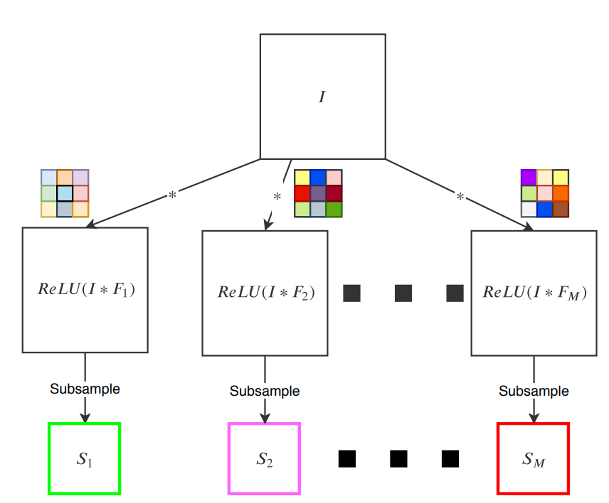
Building blocks of CNN

Slide 22
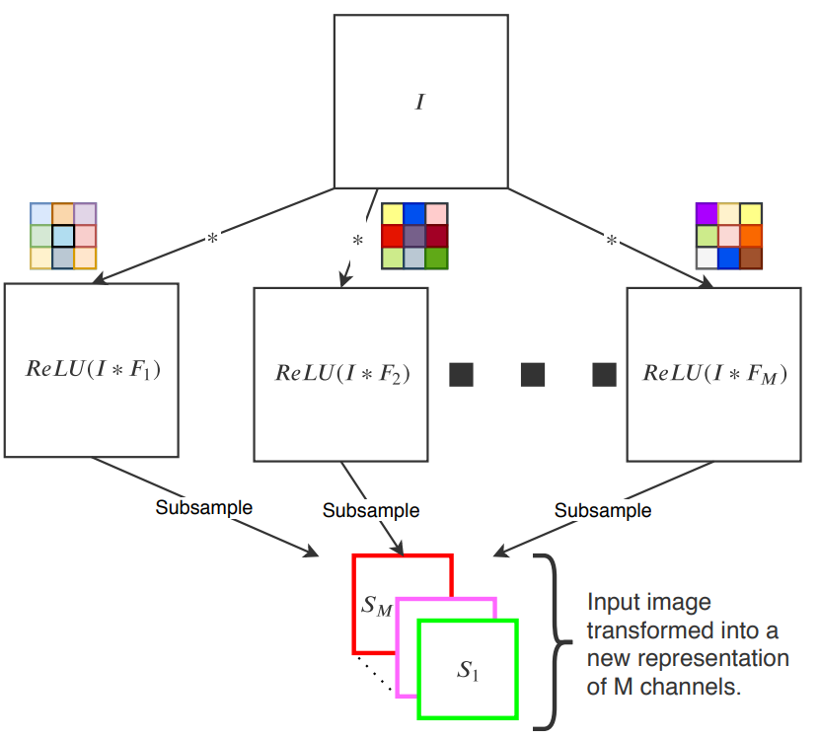
Building blocks of CNN

Slide 23
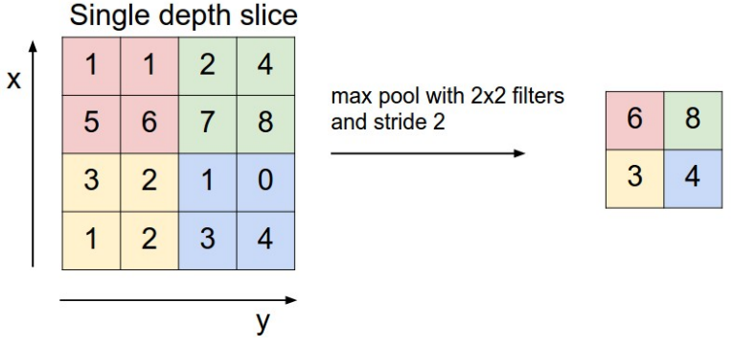
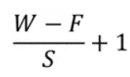
Pooling layer/Subsampling layer
Reduces the spatial dimensions of the previous layer by downsampling. Also called pooling layer.
No adjustable weights. Just a fixed down sampling procedure.
Reduces computations in subsequent layers.
Reduces number of weights in subsequent layers. This reduces overfitting
Note that pooling with larger receptive fields discards too much data.
Subsampling layer can be skipped if convolution layers uses stride>1 since that also produces a subsampled output.
Depending upon the method used, there are several types of Pooling operations.
Max pooling
Average pooling
Resultant size:

Slide 24
Pooling layer: Max pooling n=4x4, filter 2x2, stride=2
1 | 3 | 2 | 1
2 | 9 | 1 | 1
1 | 3 | 2 | 3
5 | 6 | 1 | 2

Slide 25
Pooling layer: Max pooling
n=5x5, filter 3x3, stride=1
1 | 3 | 2 | 1 | 3
2 | 9 | 1 | 1 | 5
1 | 3 | 2 | 3 | 2
8 | 3 | 5 | 1 | 0
5 | 6 | 1 | 2 | 9

Slide 26
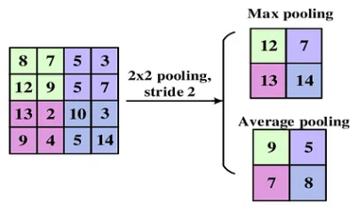
Pooling layer: MAX pooling, Average pooling

Slide 27
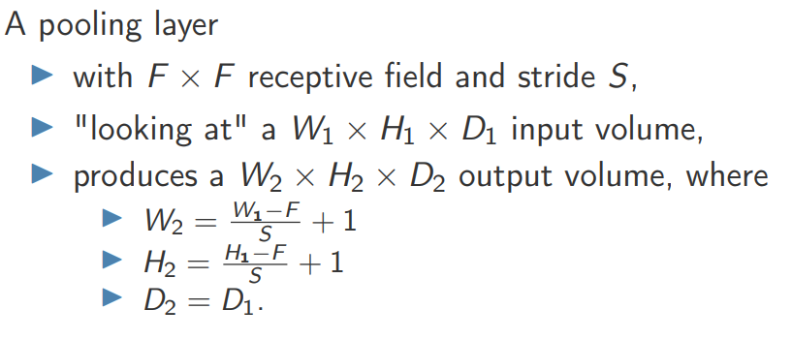
Summary of pooling layer

Slide 28
Fully-connected layer
The Fully Connected (FC) layer consists of the weights and biases along with the neurons and is used to connect the neurons between two different layers.
These layers are usually placed before the output layer and form the last few layers of a CNN Architecture.

Slide 29
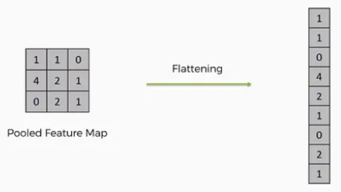
Flatten
Flattening is used to convert all the resultant 2-Dimensional arrays from pooled feature maps into a single long continuous linear vector. The flattened matrix is fed as input to the fully connected layer to classify the image.

Slide 30
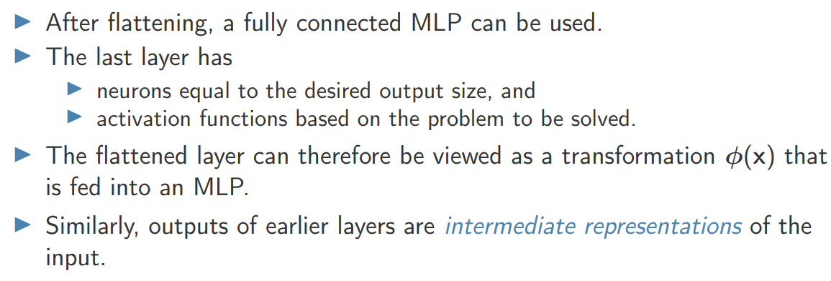
Fully connected layers

Slide 31
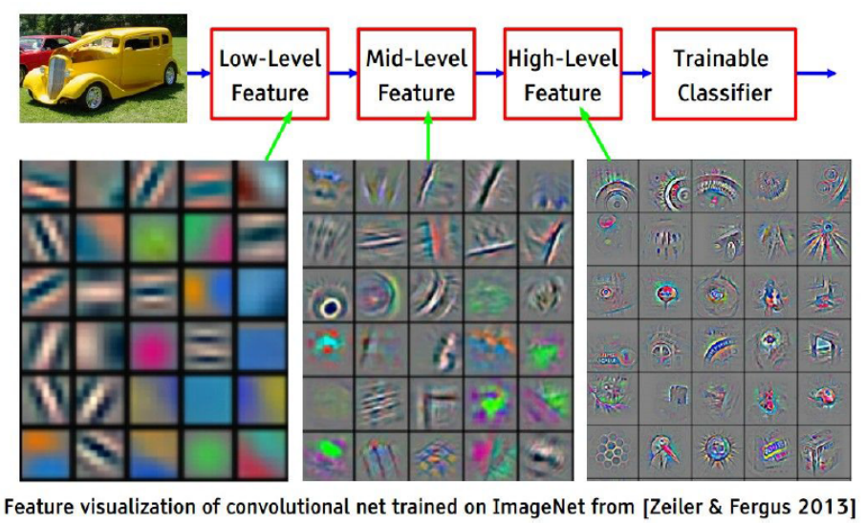
Intermediate representation

Slide 32
Intermediate representation
Layer 1 Layer 3 Layer 2

Slide 33
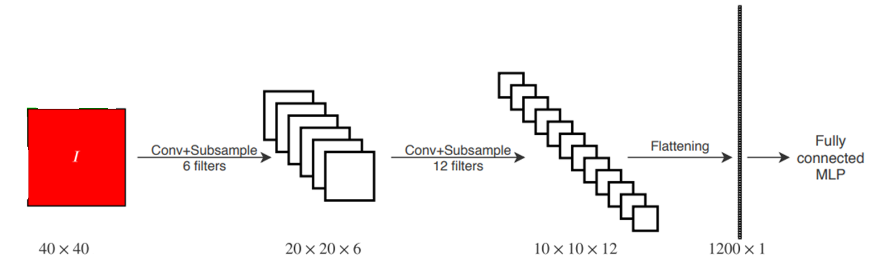
CNN
Convolution by M filters produces M channels.
They represent an M-channel transformation of the input image I.
This M-channel image can now be transformed further via additional convolution filters.
Convolution-subsampling block can be repeated multiple times.
I → M1 channels → M2 channels → · · · → Mb channels → flattening → MLP

Slide 34
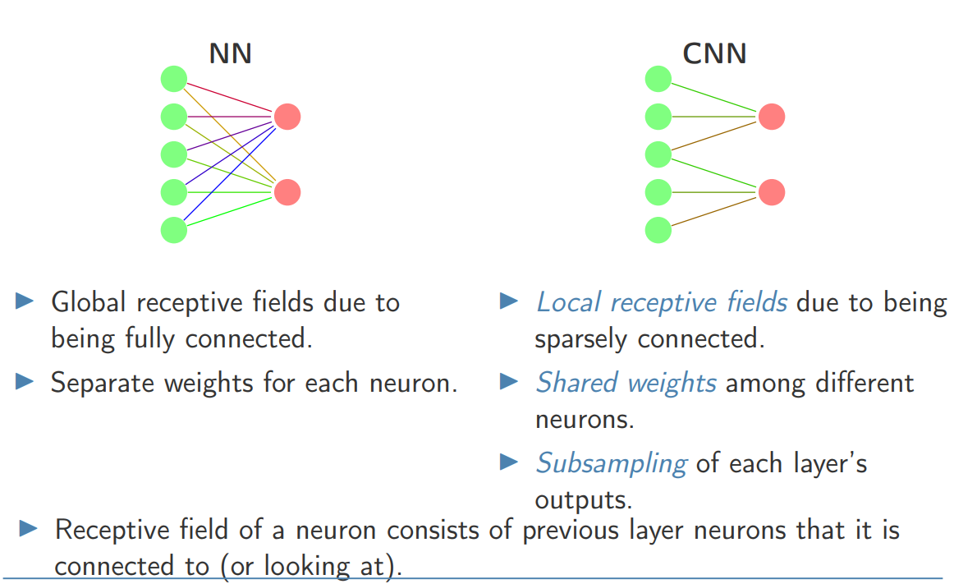
NN vs CNN

Slide 35
Convolutional layer
Consists of multiple arrays of neurons. Each such array is called a slice or more accurately feature map.
Each neuron in a feature map
is connected to only few neurons in the previous layer, but
uses the same weight values as all other neurons in that feature map.
So within a feature map, we have both
local receptive fields, and
shared weights.

Slide 36
Convolutional layer
Example: A feature map may have
100 neurons placed in a 10 × 10 array, with
each neuron getting input from a 5 × 5 patch of neurons in the previous layer (receptive field), and
the same 26(= 5 × 5 + 1) weights shared between these 100 neurons.
Viewed as detectors, all 100 neurons detect the same 5 × 5 pattern but at different locations of the previous layer.
Different feature maps will learn to detect different kinds of patterns.
For example, one feature map might learn to detect horizontal edges while others might learn to detect vertical or diagonal edges and so on.

Slide 37
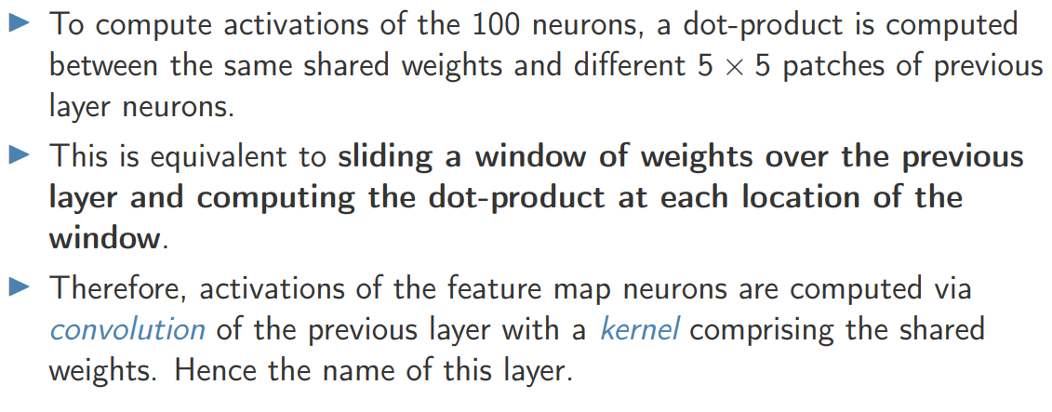
Convolutional Layer

Slide 38
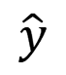
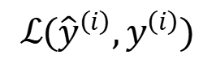
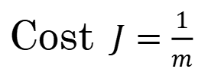

Putting it together
Training set$(x^{\left(1\right)}{,y}^{\left(1\right)})$ $…(x^{\left(m\right)}{,y}^{\left(m\right)})$.
$$\hat{y}$$
Cost $J=\frac{1}{m}$
$$\sum_{i=1}^{m}{ }$$
$$ℒ({\hat{y}}^{\left(i\right)},y^{\left(i\right)})$$
Use gradient descent to optimize parameters to reduce $J$

